Slide 1
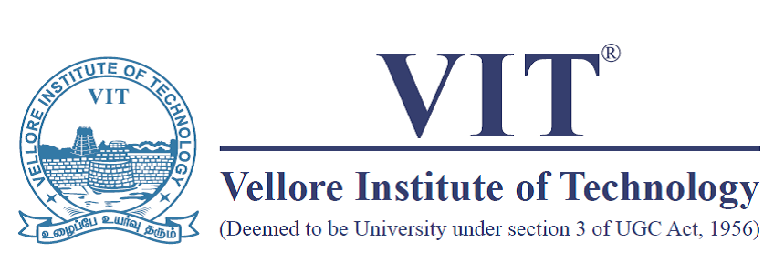
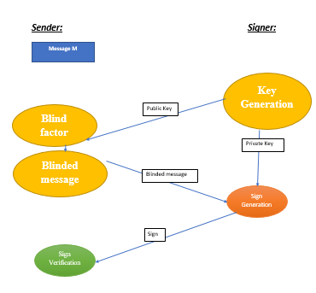
AUTHENTICATION BASED HYBRID CRYPTOSYSTEM
LINGA MOORTHY(20BCA0060) GURUPRASATH (20BCA0118) | DR.CHANDRASEGAR T |SITE
OBJECTIVES
TIME CONSUMPTION
To create and ensure the various phases of hybrid
cryptosystem.
Such as key generation , encryption , decryption , sign generation , sign verification.
SCOPE OF THE PROJECT
Our project's goal is to create a new algorithm using the Linear RSA and RSA to improve the security by using minimal bit with less time consumption
METHODOLOGY
Key generation : creating a pair of keys such as public key and a private key
Encryption : converting plain text into a coded message that can only be read by someone who has the key to decrypt it.
Decryption : converting an encrypted message back into its original, readable form
Sign generation : is the process of creating a digital signature for a message or document.
Sign verification : is the process of verifying the authenticity and integrity of a digital signature
SYSYTEM ARCHITECTURE
Conclusion/ Summary
Blind Signature is a form of digital signature in which the content of a message is disguised (blinded) before it is signed. Blind signatures are typically employed in privacy-related protocols where the signer and message author are different parties. Blind signatures can be used to authenticate the source of messages.
Contact Details
guruprasath.a2020@vitstudent.ac.in
Lingamoorthy.v2020@vitstudent.ac.in
Acknowledgments/ References
I am so much thankful of Prof. DR.CHANDRASEGAR T
for guiding me and encouraging me to do more research

